Slide 1

Financial Understanding Program
An overview

Slide 2
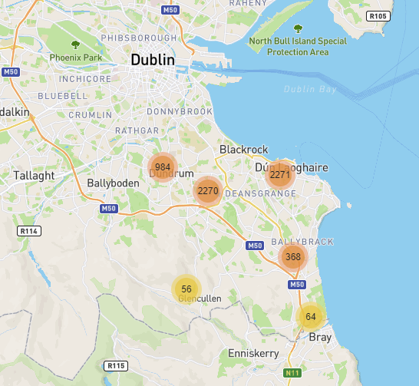
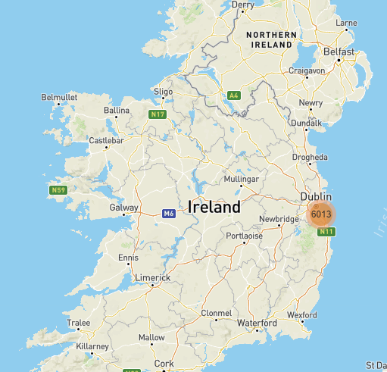
DLR

Slide 3



3 KEY STATE PLAYERS IN THE IRISH SUPPORT ECOSYSTEM
Train
Grant aid
Mentor
Startup/ micro
FDI
Indigenous

Slide 4
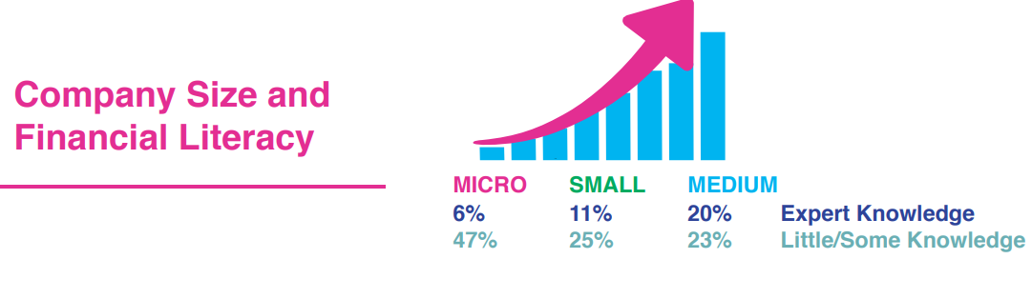
ONE OF OUR BIG CHALLENGES
Previous efforts
Worked with accountancy bodies – hard sell – no take-up
Workshops/ training – limited impact – small changes
Mentoring – specific challenges only

Slide 5

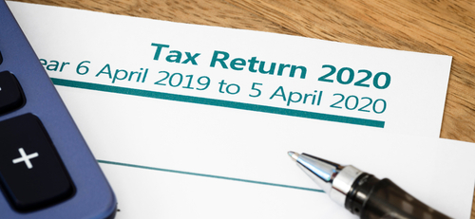
COMMON
RELATIONSHIP WITH ACCOUNTANT

Slide 6
Accountancy should be beyond regulation
Identify products/ services that are making/ losing money
Compare industry norms re margins, productivity etc
Identify business patterns/ seasonality
Budgeting/ cashflow to limit stress (at a minimum)
Identify opportunities for cost cutting
Objective analysis of any business activity i.e. product development/ ROI
Forward plan for scaling in any direction
etc

Slide 7
Programe Objectives
Develop an interest/ awareness of the power of numbers
Give proper context
Provide the language to have these conversations with accountants
Making training relevant to the audience
Non technical – what KPIs and interpreting same
Influence a numbers habit to make decisions
Ability to identify the right financial software/ platforms

Slide 8
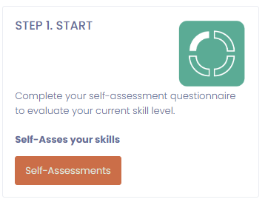
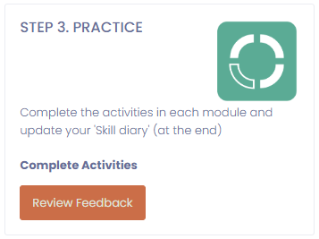
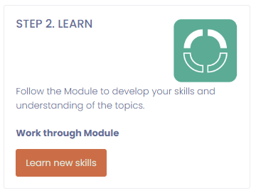
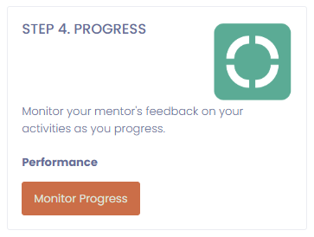
Financial Understanding App
Self assessment
Content
Mentor
Practice

Slide 9
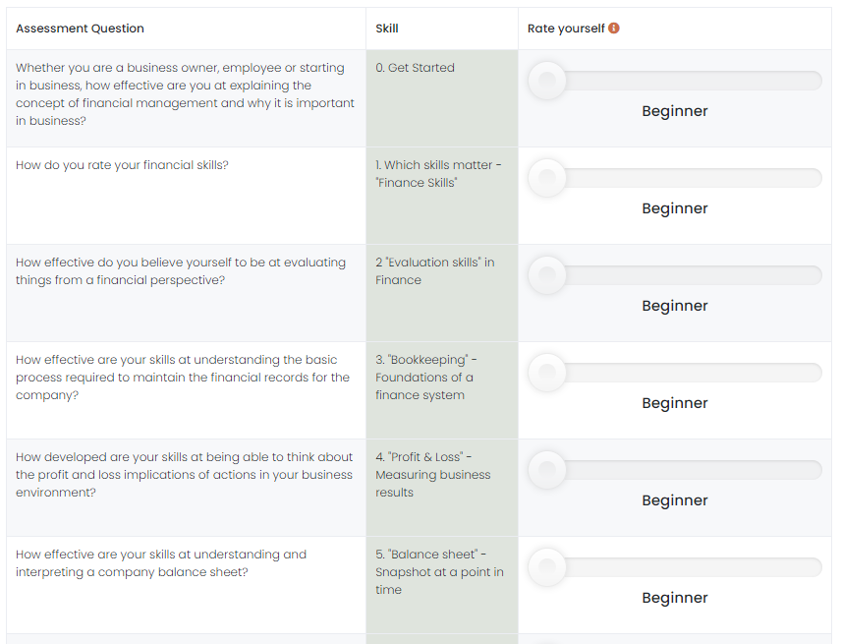
SELF ASSESMENT
Provoke

Slide 10
STATUS
Beta launch
37 clients signed up
Learnings
- What scale company - Needs to be
applicable
- Requirement for immediate benefit
- Time efficient for user
- Usability
- Importance of strong mentoring

Slide 11
Thank you
Olaverty@dlrcoco.ie

Slide 12
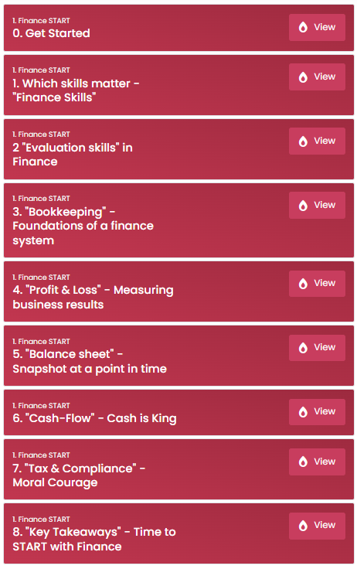
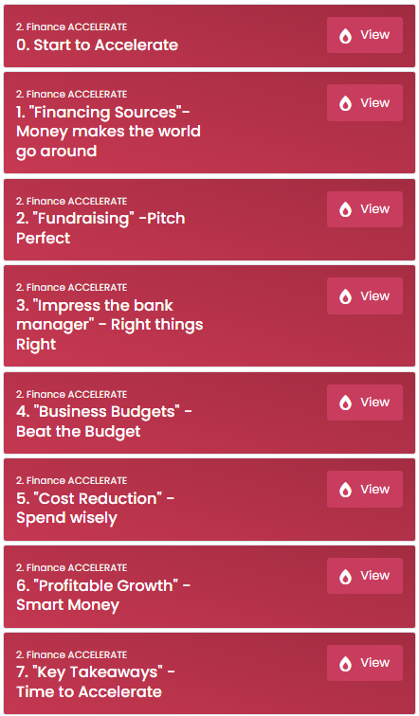
CONTENT
2 LEVELS
START
ACCELERATE

